Slide 1



AGE 214: Lecture 2
Classification of Materials: Intrinsic vs. Extrinsic
Sokoine University of Agriculture
AGE 214 - Lecture 2

Slide 2



Recap: Intrinsic Semiconductors
Pure Silicon (Si)
Problem
•
Structure: Crystalline lattice, 4 valence electrons.
•
At Room Temp: Few electron-hole pairs generated thermally.
Too few free carriers (High Resistance).
•
Conductivity: Very low. Not very useful for making devices on its own.
Solution
The Solution? We must change the conductivity chemically.
Doping: Adding impurities.
Sokoine University of Agriculture
AGE 214 - Lecture 2

Slide 3






What is Doping?
Definition
The Ratio
Result
The deliberate addition of specific impurities to a pure semiconductor to alter its electrical properties.
Typically 1 impurity atom for every 106 to 108 Silicon atoms. A tiny amount makes a huge difference.
Creates an Extrinsic Semiconductor with significantly increased conductivity.
Sokoine University of Agriculture
AGE 214 - Lecture 2

Slide 4
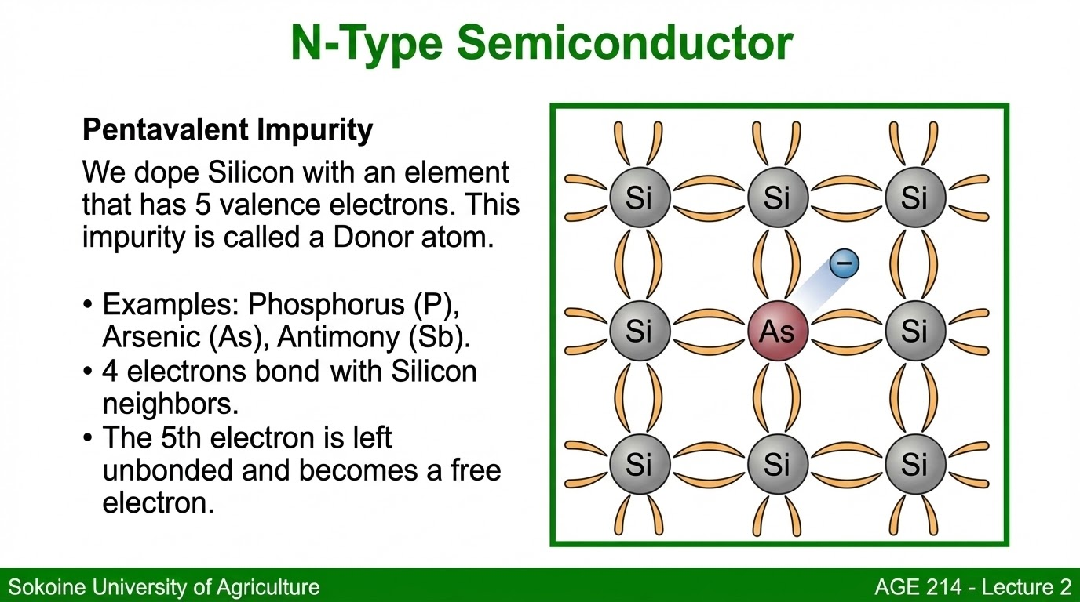

Slide 5



N-Type Carriers
Majority Carriers
Minority Carriers
Electrons
Holes
Created by the doping atoms. They vastly outnumber the holes.
Generated only by thermal energy (heat breaking bonds).
Remember: "N" stands for Negative charge carrier (Electron).
Sokoine University of Agriculture
AGE 214 - Lecture 2

Slide 6

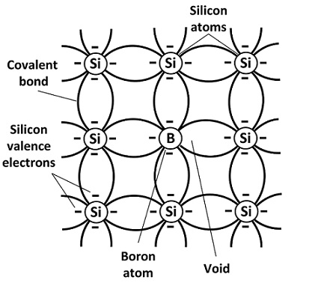
P-Type Semiconductor
Trivalent Impurity
We dope Silicon with an element that has 3 valence electrons.
•
Examples: Boron (B), Gallium (Ga), Indium (In).
•
3 electrons bond with Silicon neighbors.
•
The 4th bond is incomplete, creating a Hole.
This impurity is called an Acceptor atom (it accepts an electron).
Sokoine University of Agriculture
AGE 214 - Lecture 2

Slide 7

P-Type Carriers
Majority Carriers
Minority Carriers
Holes
Electrons
Created by the doping atoms. They outnumber the electrons.
Generated only by thermal energy.
Remember: "P" stands for Positive charge carrier (Hole).
Sokoine University of Agriculture
AGE 214 - Lecture 2

Slide 8

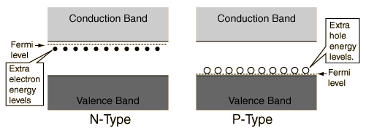
Energy Band Impact
New Energy Levels
Doping introduces new energy states within the forbidden gap.
•
N-Type: Adds a Donor Level just below the Conduction Band. Electrons easily jump up.
•
P-Type: Adds an Acceptor Level just above the Valence Band. Electrons easily jump up, leaving holes behind.
Sokoine University of Agriculture
AGE 214 - Lecture 2

Slide 9
Mass Action Law
Relationship Between Carriers
Under thermal equilibrium, the product of free electron concentration (n) and hole concentration (p) is constant.
Where ni is the intrinsic carrier concentration.
This means if we increase electrons (via N-doping), the number of holes must decrease proportionately to keep the product constant.
Sokoine University of Agriculture
AGE 214 - Lecture 2

Slide 10
Electrical Conductivity
Conductivity (σ)
The ability to conduct depends on charge (q), carrier density (n, p), and mobility (μ).
•
For N-Type: σ ≈ q n μn (since n >> p)
•
For P-Type: σ ≈ q p μp (since p >> n)
Sokoine University of Agriculture
AGE 214 - Lecture 2

Slide 11
Comparison Summary
Feature | N-Type | P-Type
Doping Atom | Pentavalent (5 valence e-) | Trivalent (3 valence e-)
Examples | Phosphorus, Arsenic | Boron, Gallium
Majority Carrier | Electrons | Holes
Minority Carrier | Holes | Electrons
Impurity Name | Donor | Acceptor
Sokoine University of Agriculture
AGE 214 - Lecture 2

Slide 12
Questions?
Next Lecture: The PN Junction Diode
Dr. Kadeghe Fue
Sokoine University of Agriculture
AGE 214 - Lecture 2

Slide 13




https://upload.wikimedia.org/wikipedia/en/c/c1/SUA.png
Source: wikipedia.org
https://www.campuscomponent.com/Diffrence%20between%20P%20and%20N%20type%20semiconductor%20-2-.jpg
Source: www.campuscomponent.com
https://www.elprocus.com/wp-content/uploads/p-type-semiconductor-doping.jpg
Source: www.elprocus.com
http://hyperphysics.phy-astr.gsu.edu/hbase/Solids/imgsol/dban.gif
Source: hyperphysics.phy-astr.gsu.edu

